Slide 1
Using MVVM Architecture for SpasticityClient
Performance – Scalability – Intuitive Logic

Slide 2
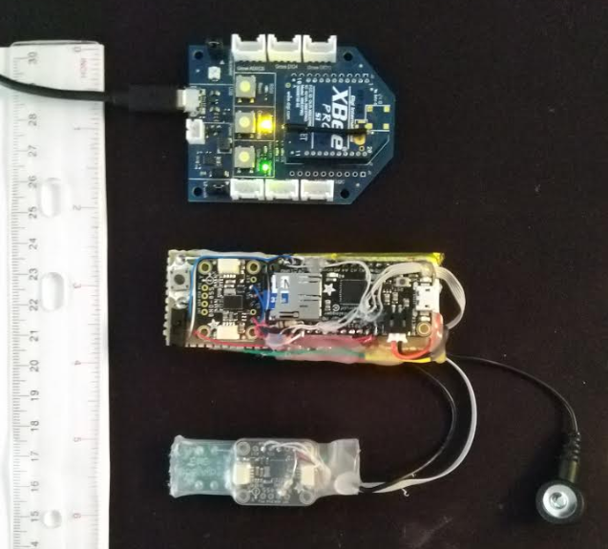
SpasticityClient
Software to capture EMG, Force, Angle, and Angular Velocity
Multiple data sources to aid in diagnosing spasticity and differentiating from tone issues
Reciever
To PC
Worn on static side of joint (transmitter)
Worn on moving side of joint

Slide 3
Model-View-Viewmodel (MVVM) architecture
What is MVVM Architecture? – A way of splitting up structural elements of the code depending on what they do.
MODEL – This is the data object.
VIEW – What the user sees on their screen and allows the user to interact with back end logic. Binds to properties on viewmodel.
VIEWMODEL – Code files with properties and functions needed for the views to operate. Expose data objects from the model.

Slide 4
Advantages?
Intuitive: Code is broken up by function, so you know where to look if you want to change something.
Modular: No cascading effects throughout code – functional changes can be by changing only the relevant element. Multiple programmers can work on different parts without conflicts.
Scalable: The above qualities mean that further development and scale-up can be done fast and project handoff is smooth, saving time and money.
Any disadvantages? – Can be “overkill” for very simple UI or app logic. The pattern is also not always applicable.

Slide 5
MVVM Mini Game!
MainWindow.xaml
AngVelChart.xaml
EMGChart.xaml
XBeeData.cs
XBeeData.cs
ChartModel.cs
ChartModel.cs
AngleChart.xaml
ForceChart.xaml
XBeeData.cs
XBeeData.cs
ChartModel.cs
ChartModel.cs
MainWindowViewModel.cs
LEGEND
Model
View
Viewmodel

Slide 6
Thank you! Questions?

